Slide 1
Why are some analysts a bit excited about R

Slide 2
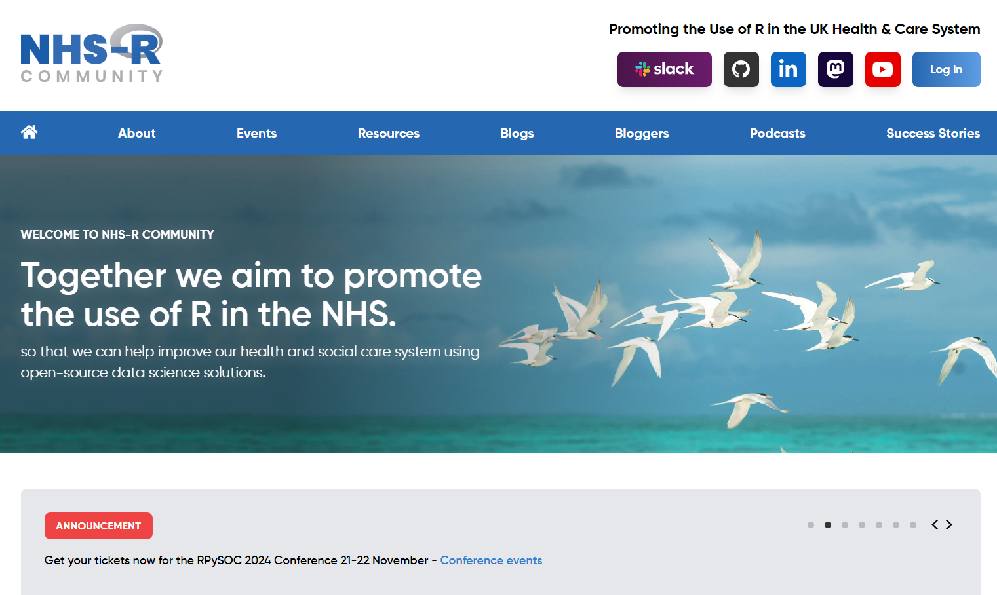


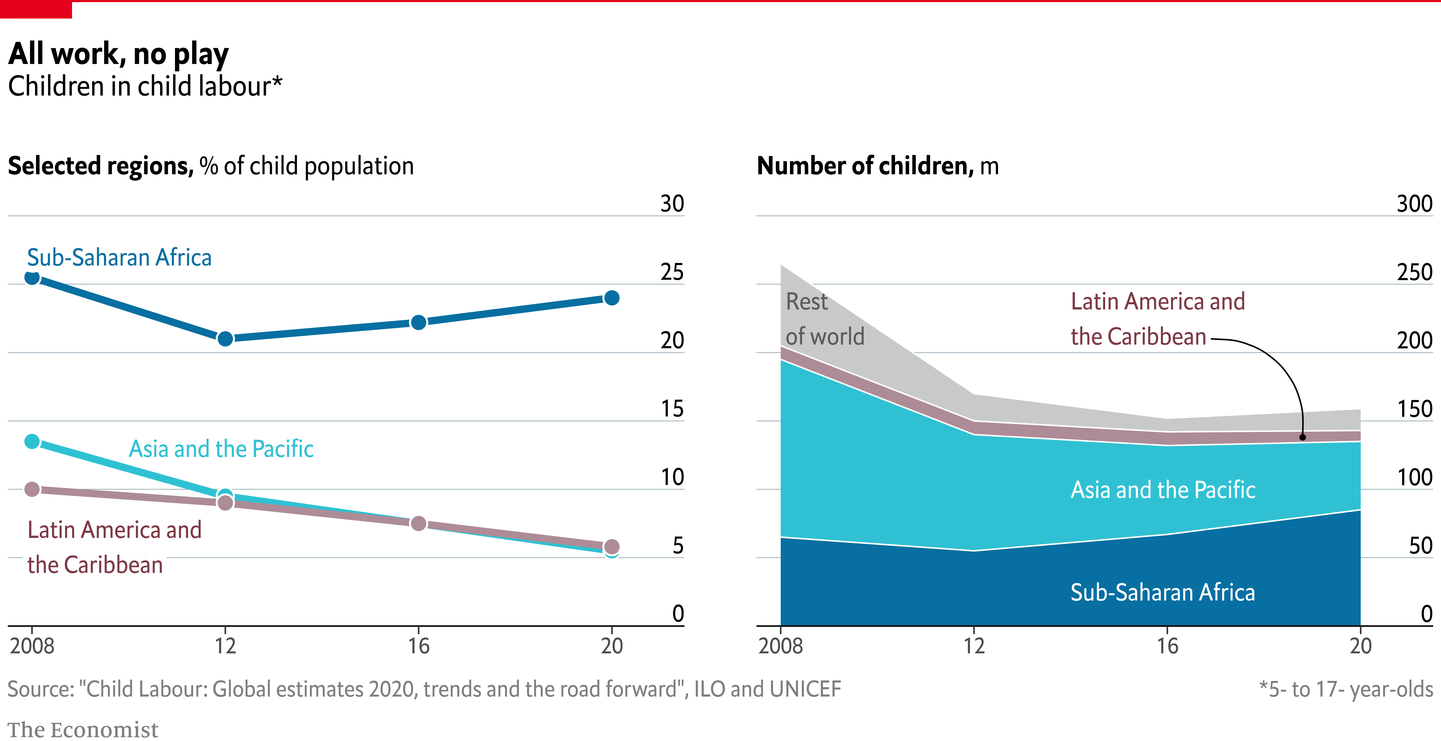
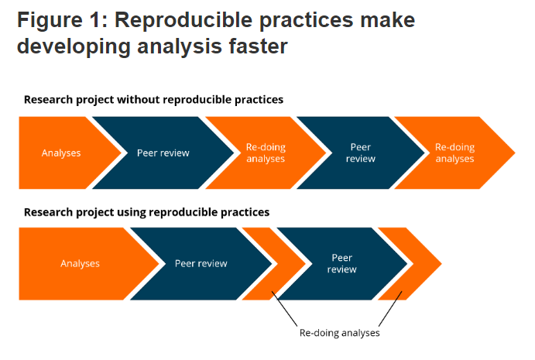

Why I think R catches on?

Slide 3
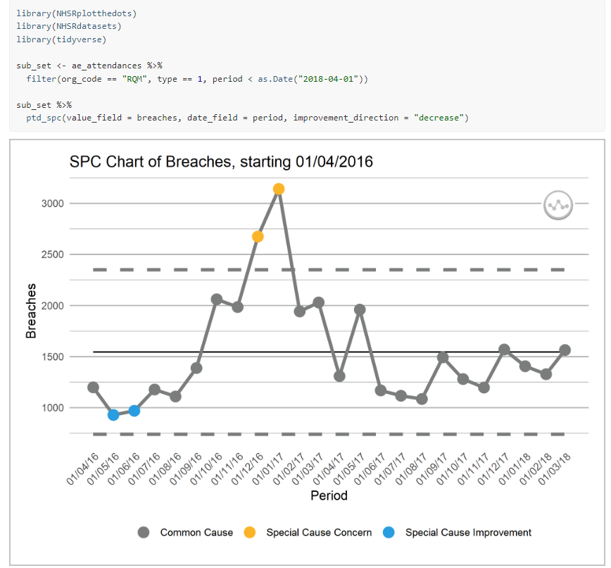
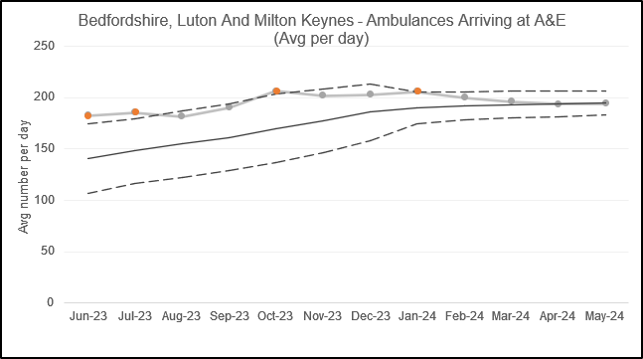

1. There’s an app for that…
R Package library is huge & comprehensive
Tidyverse: Nice data manipulation, loading that is intuitive to many
NHS R Datasets: example data
NHS Plot the dots: Apply NHS methods in a few lines
Janitor: tidy up excel imports, dates, headers
Statistics origins – Regression, time series decomposition, etc etc
Strong in social sciences / epidemiology / research
Process mining / System Dynamics

Slide 4
2. Huge Community & Support
NHS R community; Global influence, Slack, Collaboration and sharing via github sites / books, R-Ladies
NHS England R community: 300+ people, coffee and code catch ups… train-the-trainers..
Lots of training opportunities for free
Code shared via Github
NHS R conference
Friendly RAP & Python communities (NHS Digital / data science teams)
Often taught through university data science / biostatistics / maths courses (alongside Python/SPSS)
Extremely inclusive – free for all, no barriers to entry

Slide 5
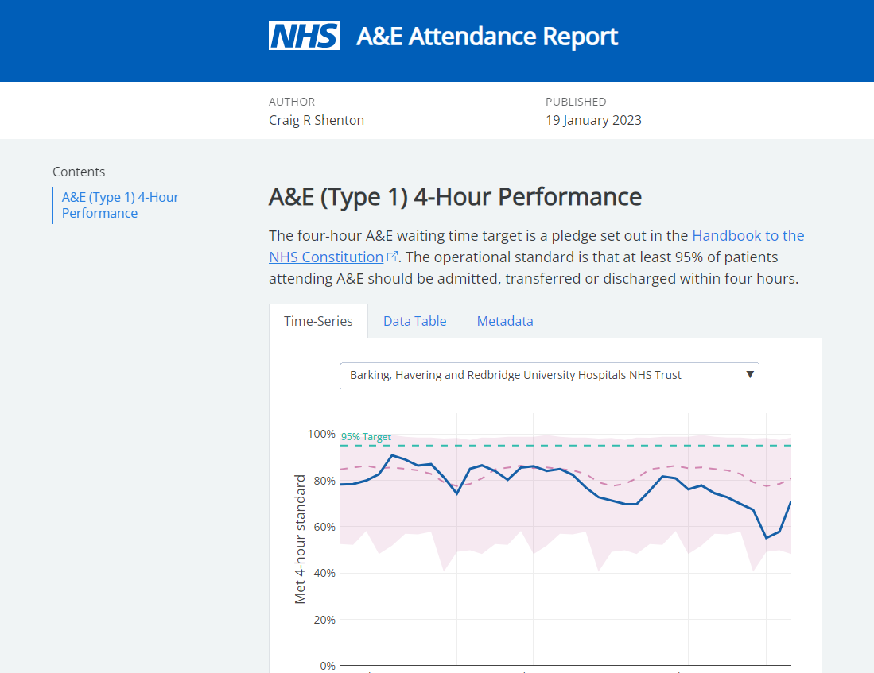
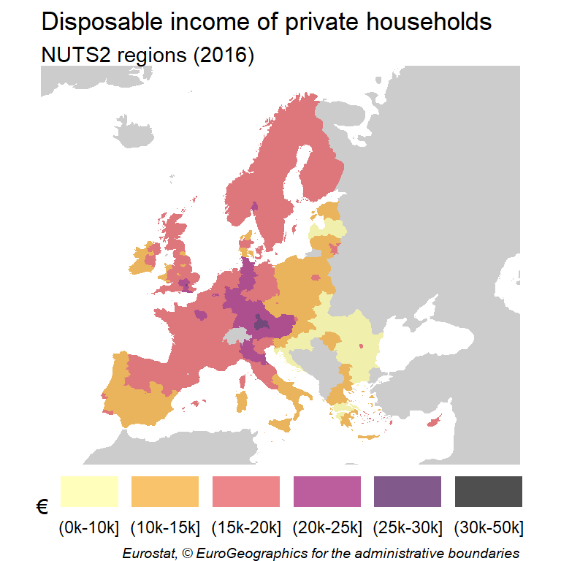
3. Really high-quality visualisations
GGPlot / Plotly – limitless opportunities for creating amazing visualisations – see gallery:
The R Graph Gallery – Help and inspiration for R charts (r-graph-gallery.com)
Maps – no problem! Free!
Share via Markdown reports, add story, narrative
Make interactive dashboards using Shiny

Slide 6
4. RAP and Automation
Running code makes life so much easier
Fewer mistaeks?
Change a line, rerun…
Run model for every permutation of ICB & TFC & Provider – far exceed scale and capacity of Excel
Github culture:
Reusing code & sharing across NHS England, ICBs, the world!
Easy of version control (from using github etc)
Best practice – Government & Goldacre review
Some downsides – not always easy to see results as you go, requires some debugging skills.

Slide 7
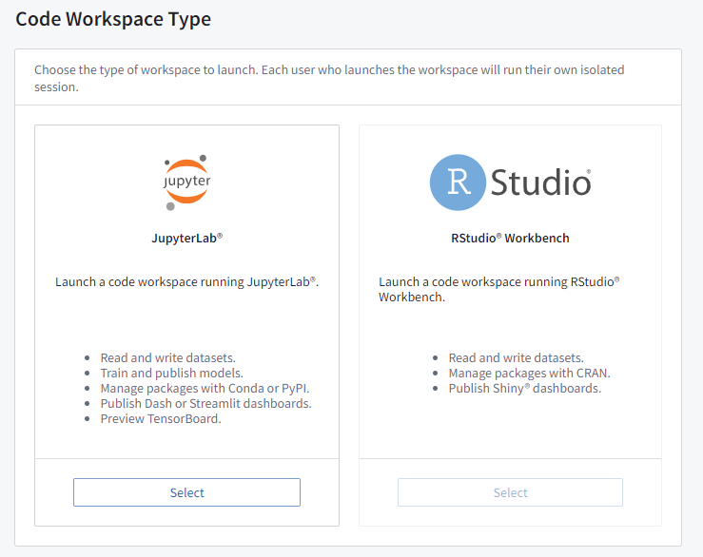
5. Works well across all our platforms
Foundry/FDP:
Code Workbook (Write code & output GGPlot/Plotly)
Code Workspace (Run Rstudio & publish things – Trial)
Quick win to get familiar environment to run R in secure way
UDAL
RStudio Client GUI
Databricks environment – at scale, access to data, big data, sensitive data (Python a bit easier here for permissions)
Interoperable with Python / SQL / Tableau / PowerBI
Desktop/Laptop
RStudio install

Slide 8
What’s frustrating for R users
Code sharing is not standardised / routine
Publishing code at risk of sharing policy
Sensitivity sharing data
Many ways to do the same thing
IT support
Different versions
Reliable environment
Sharing HTML outputs isn’t easy for customers
Really good outputs like websites, lots of interactivity and visualisations, look like PPT or Document. Email / Futures / Sharepoint – all have challenges..
But just a webpage… Put behind Okta?
Dashboards & Policy of NHS England conflict
Can run models & stuff as parameters change
Should / could we use R in place of Tableau and PowerBI? Or combine?
Possible solutions – running & sharing via Foundry / something else linked to UDAL/Azure

Slide 9
How to support R users in your teams
Encourage team to have a go. Most people learned through doing. Takes effort to overcome Excel / GUI at first. Start small.
Get them involved with communities like NHS R, Coffee & Code (300+ users in NHS England)
Get them experimenting with databricks / foundry
Encourage more RAP / Code agnostic approaches - Python good too.
Champion R use in conversation with national data platform teams
Encourage customers to embrace outputs from R
Support code sharing & public openness
Encourage “proper statistics” from your experience

